Slide 1
Qtrack

Slide 2
QTRACK
This QTrack software has five different views, each with different scenarios
Admin
Manager
TeamLeader
Modeller
QC

Slide 3
Admin
This is the Admin view for adding and maintaining user information.
Users
Views
Account Settings
Role Access

Slide 4
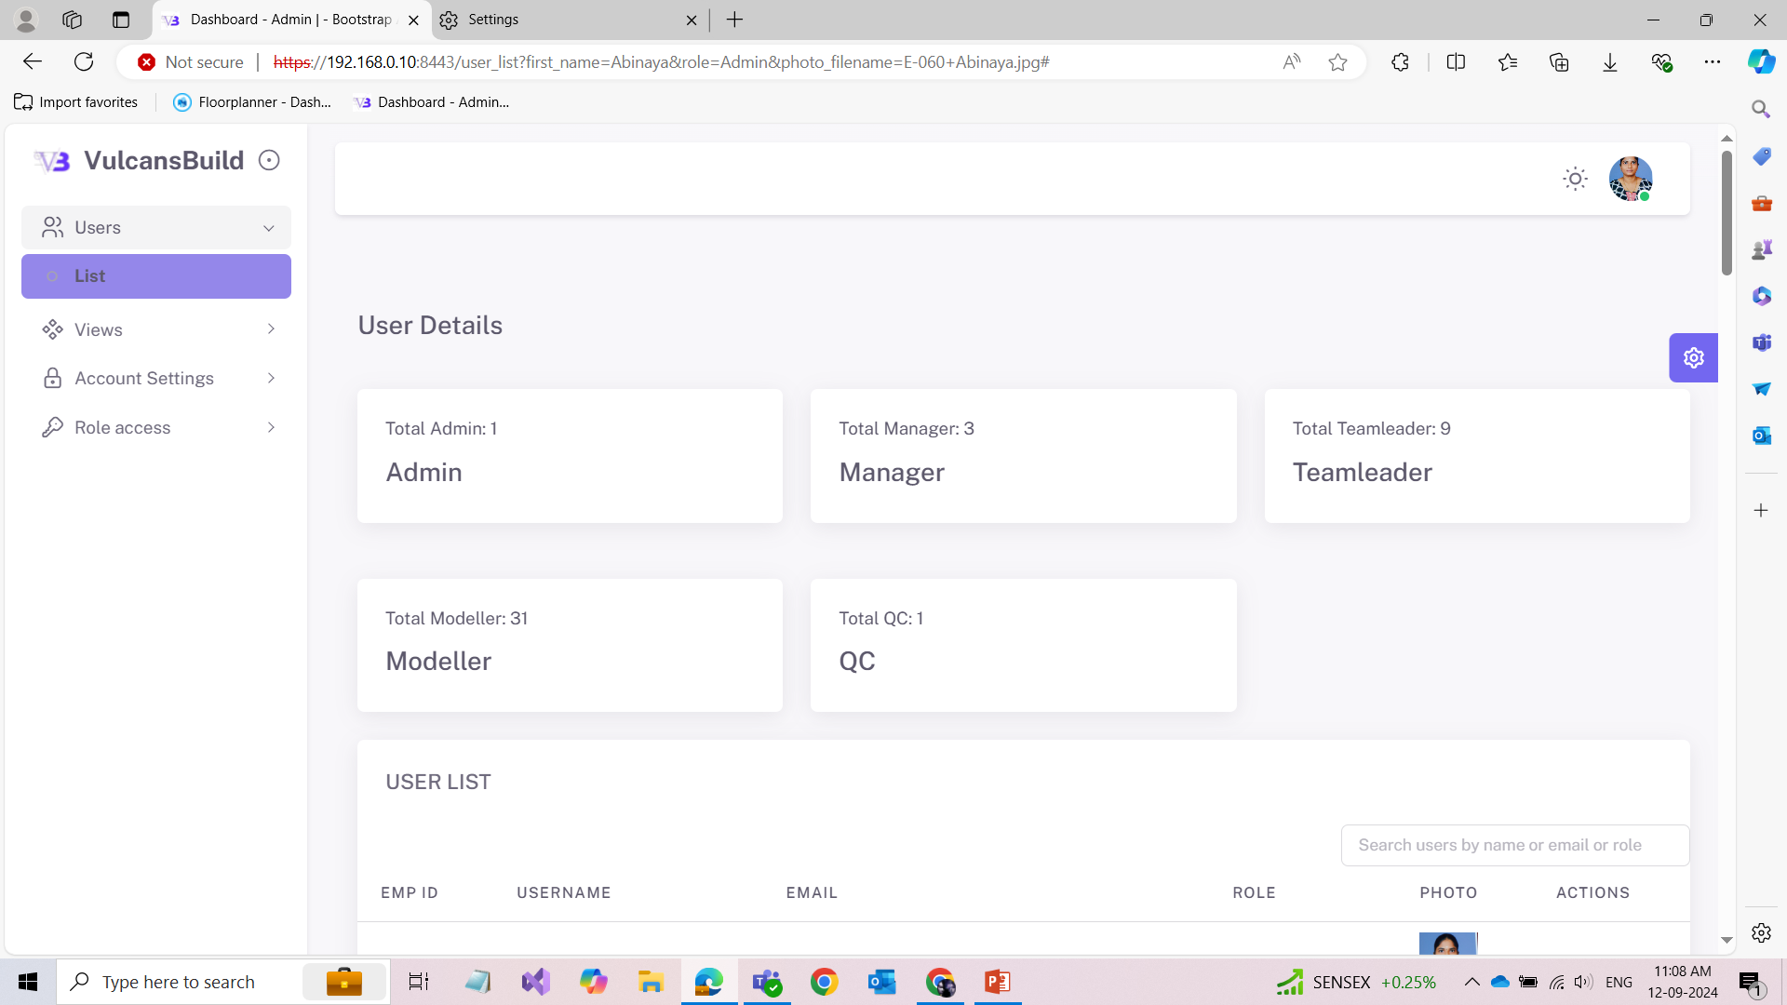
Users
The userlists are displayed under this menu.
Cards are dynamically shown based on their roles.

Slide 5
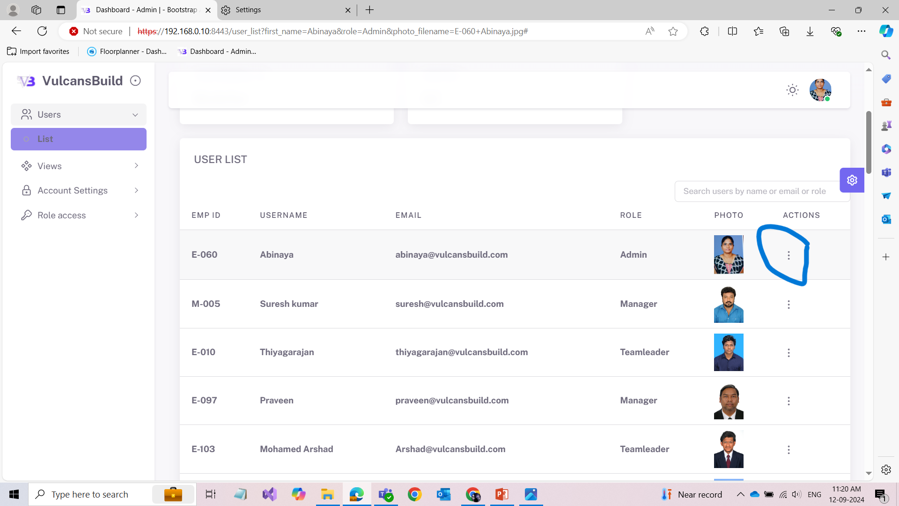
Views
Clicking on Users will show a submenu List. When you click on List, it will display the user list. From there, go to 'Action' and click on it. It will show the user's details and performance metrics.

Slide 6
Views
Clicking on Users will show a submenu List. When you click on List, it will display the user list. From there, go to 'Action' and click on it. It will show the user's details and performance metrics.

Slide 7
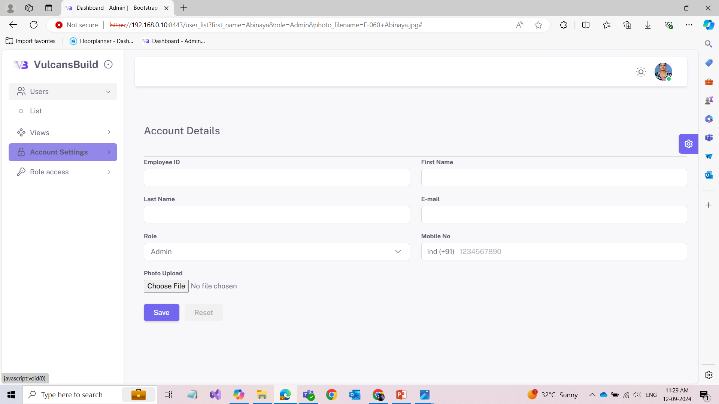
Account Settings
This the form for adding user details.

Slide 8
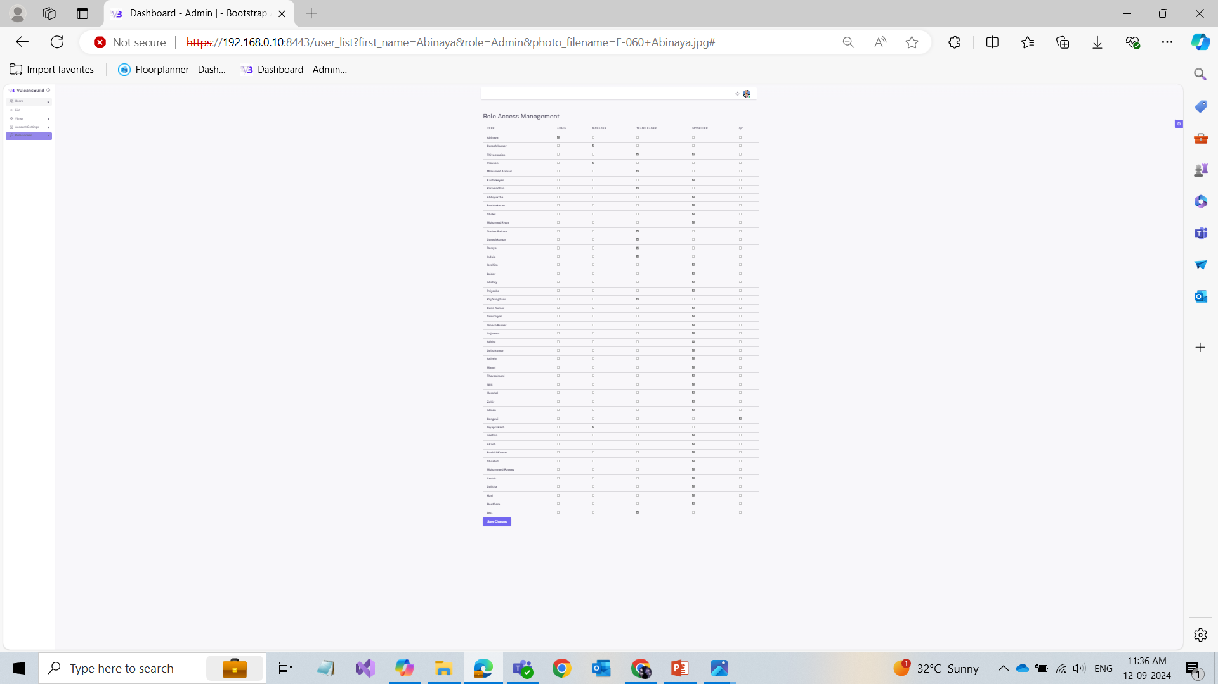
Role Access
This is the menu for assigning role access to the users.
Click on checkbox which role you want to give,then click on save changes it will gets updated.

Slide 9
Manager
Dashboards
Assign Task
QC Reports
Users
Views

Slide 10
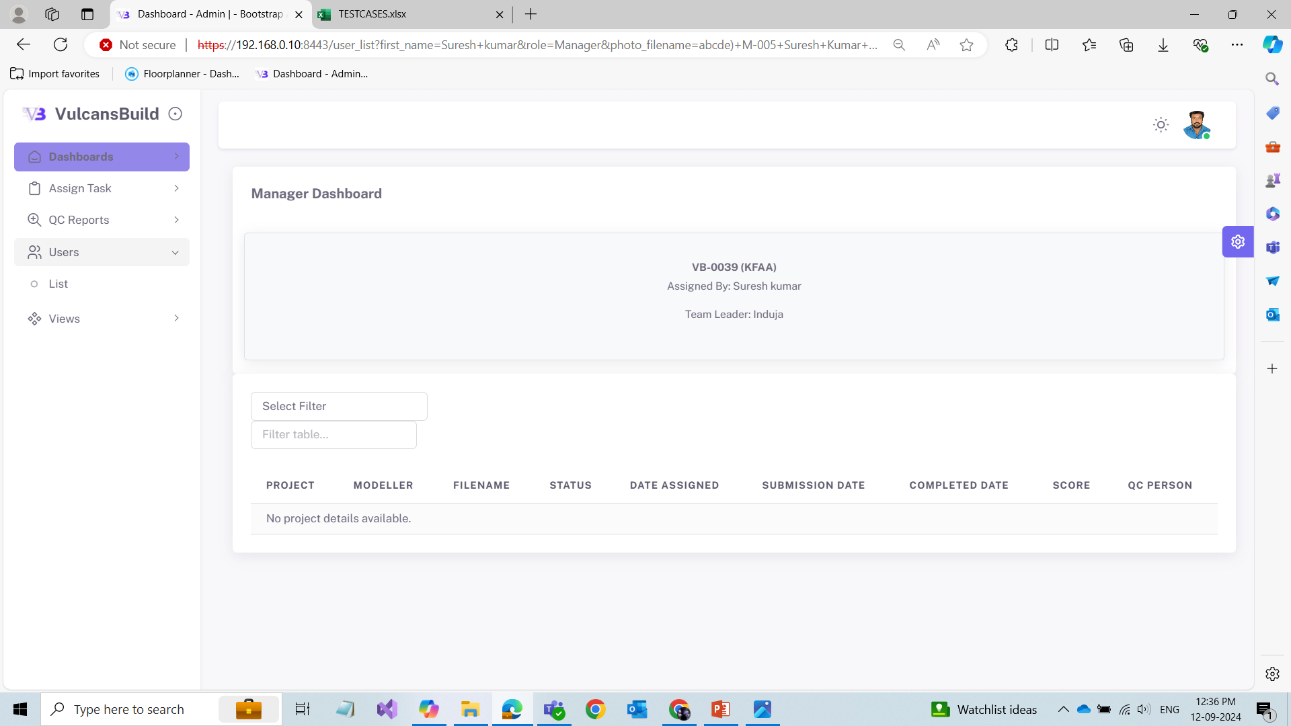
Dashboards
After assigning the projects to the Team Leader, that gets displayed in this menu.

Slide 11
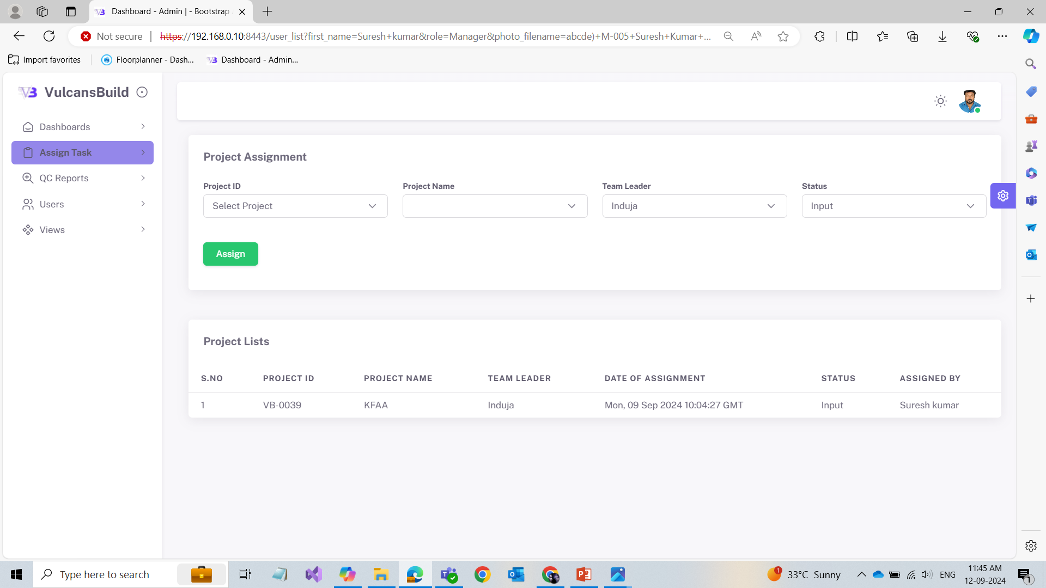
Assign Task
This is the form for assigning projects to the team leader. The assigned projects get reflected in this table.
.

Slide 12
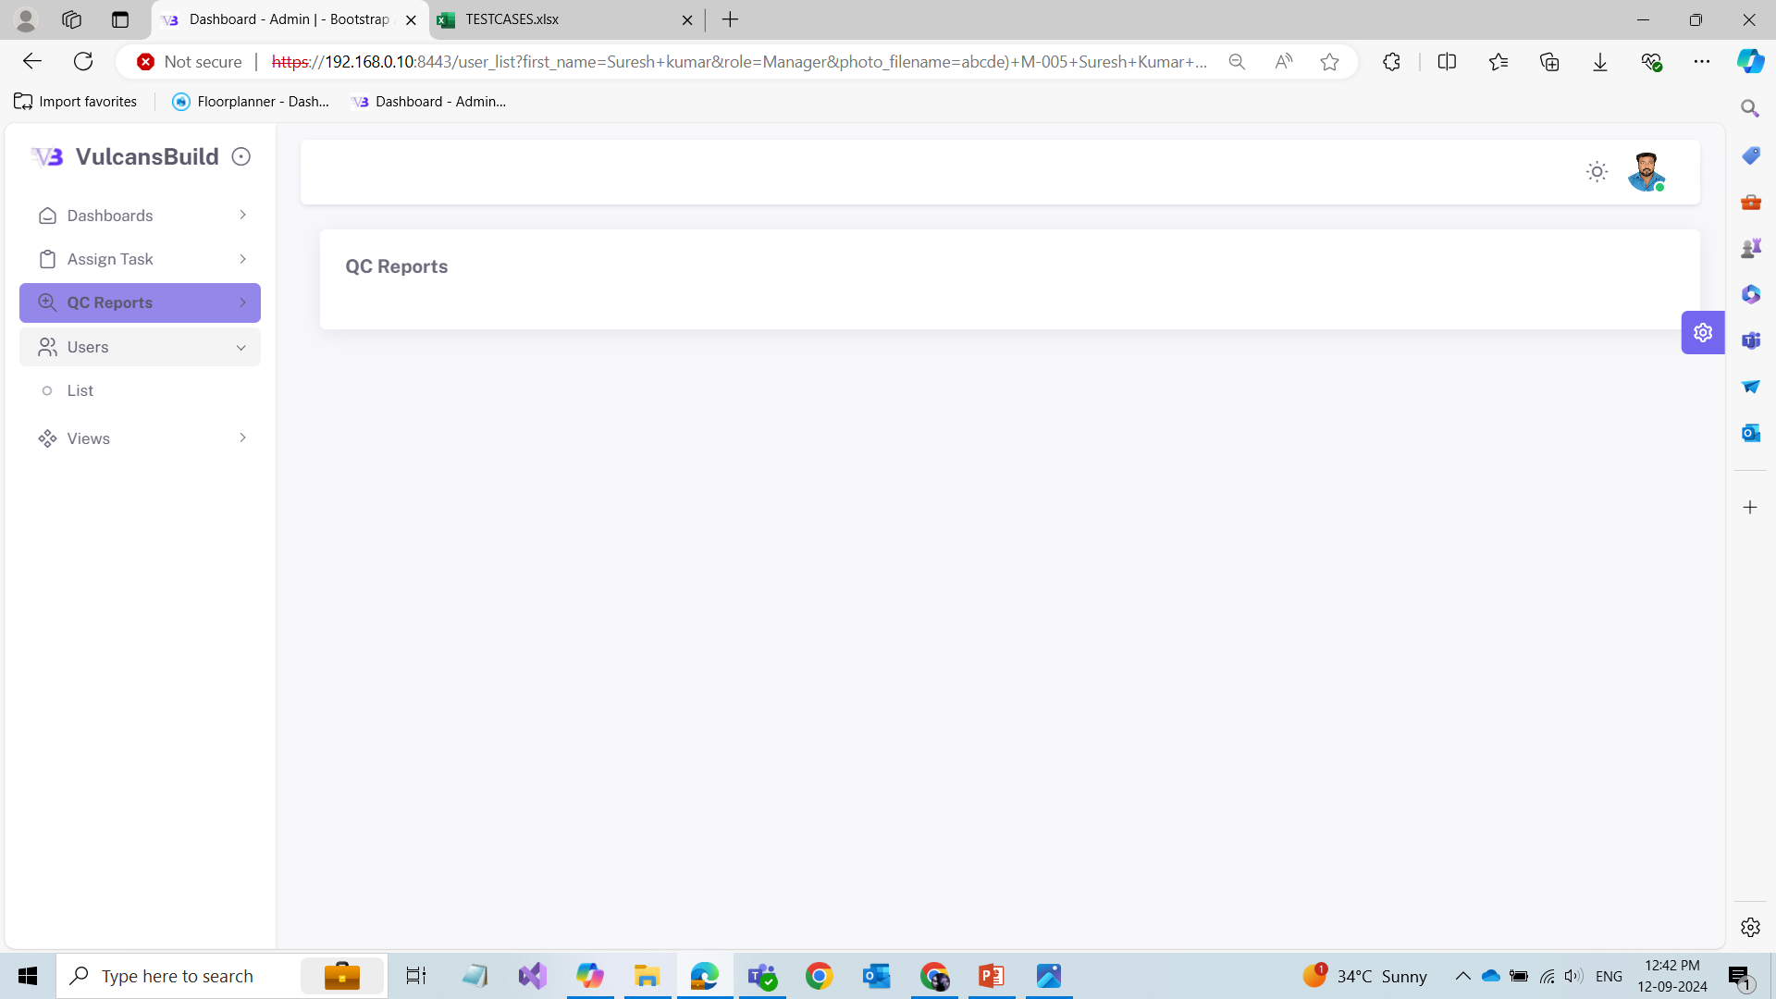
QC Reports
Whatever files above QC Score 90 means gets displayed in this menu.

Slide 13
Users
The userlists are displayed under this menu.
Cards are dynamically shown based on their roles.

Slide 14
TeamLeader
Dashboards
Assigned To Me
Assign Projects
File Reception
File Submission
Report Reception

Slide 15
Dashboards
After assigning the files to the modellers, that gets displayed in this menu

Slide 16
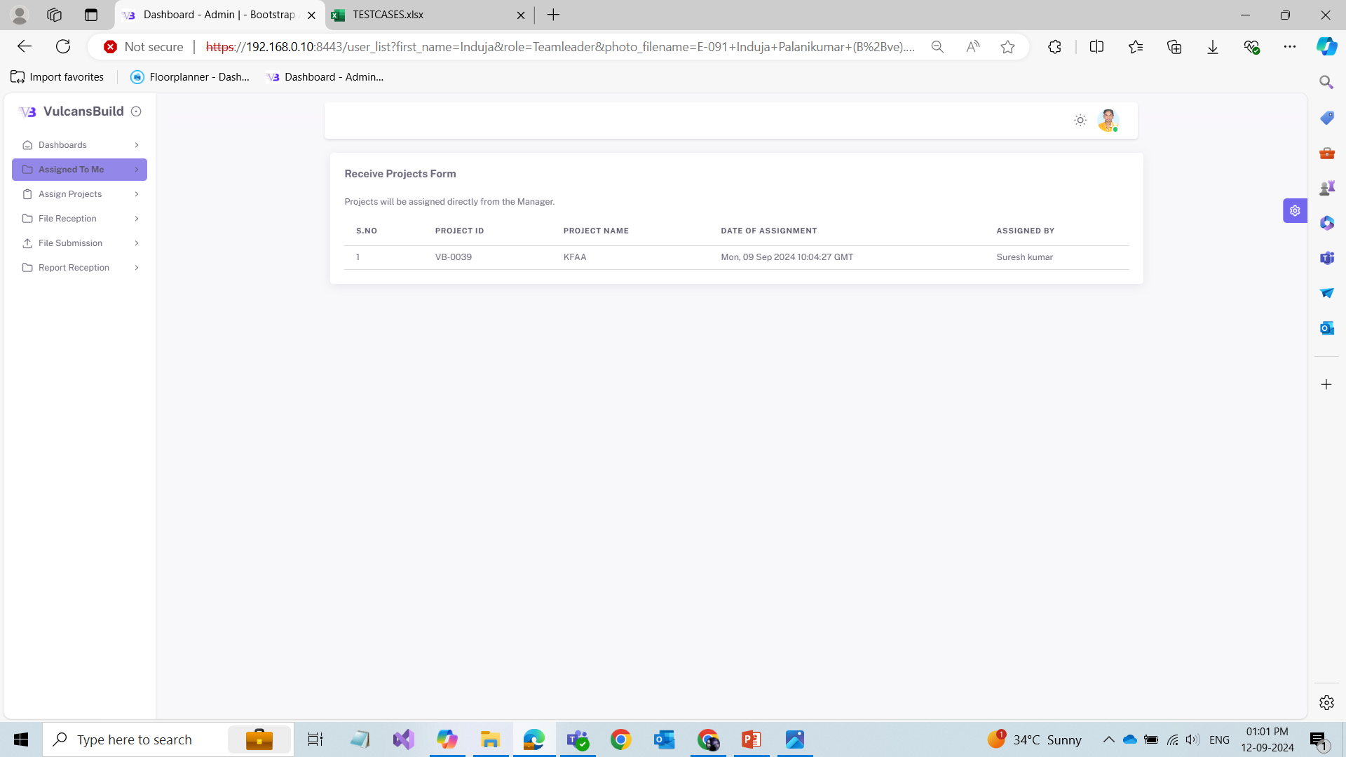
Assigned To Me
The team leader received the projects that are assigned by the manager are displayed under this menu.

Slide 17
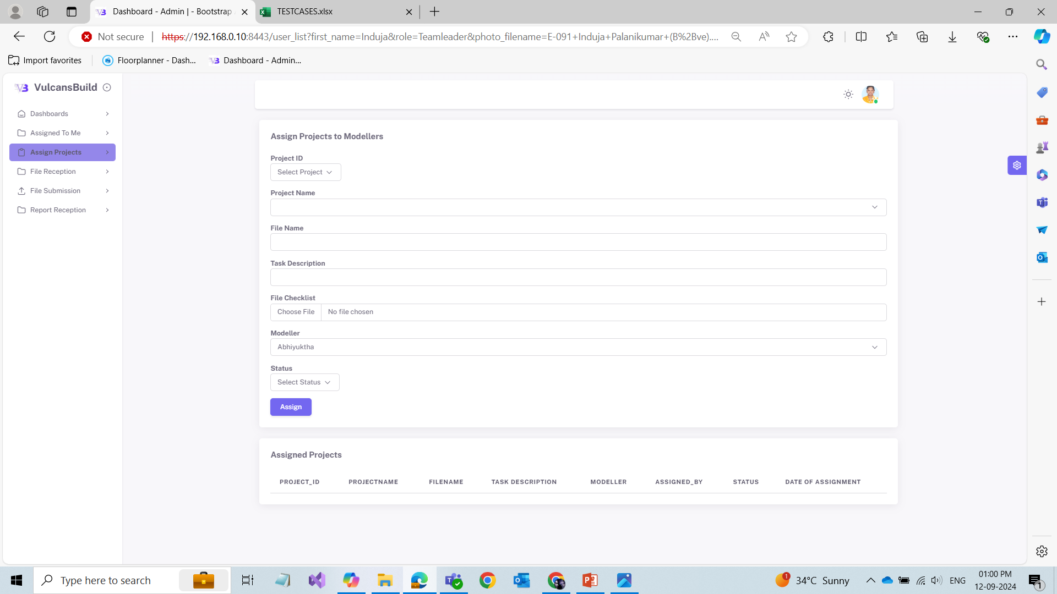
Assign Projects
After receiving the projects from the manager, the team leader (TL) has to assign the files based on the projects to the modellers. This is the form for assigning files to the modellers, which are then reflected in this table.

Slide 18
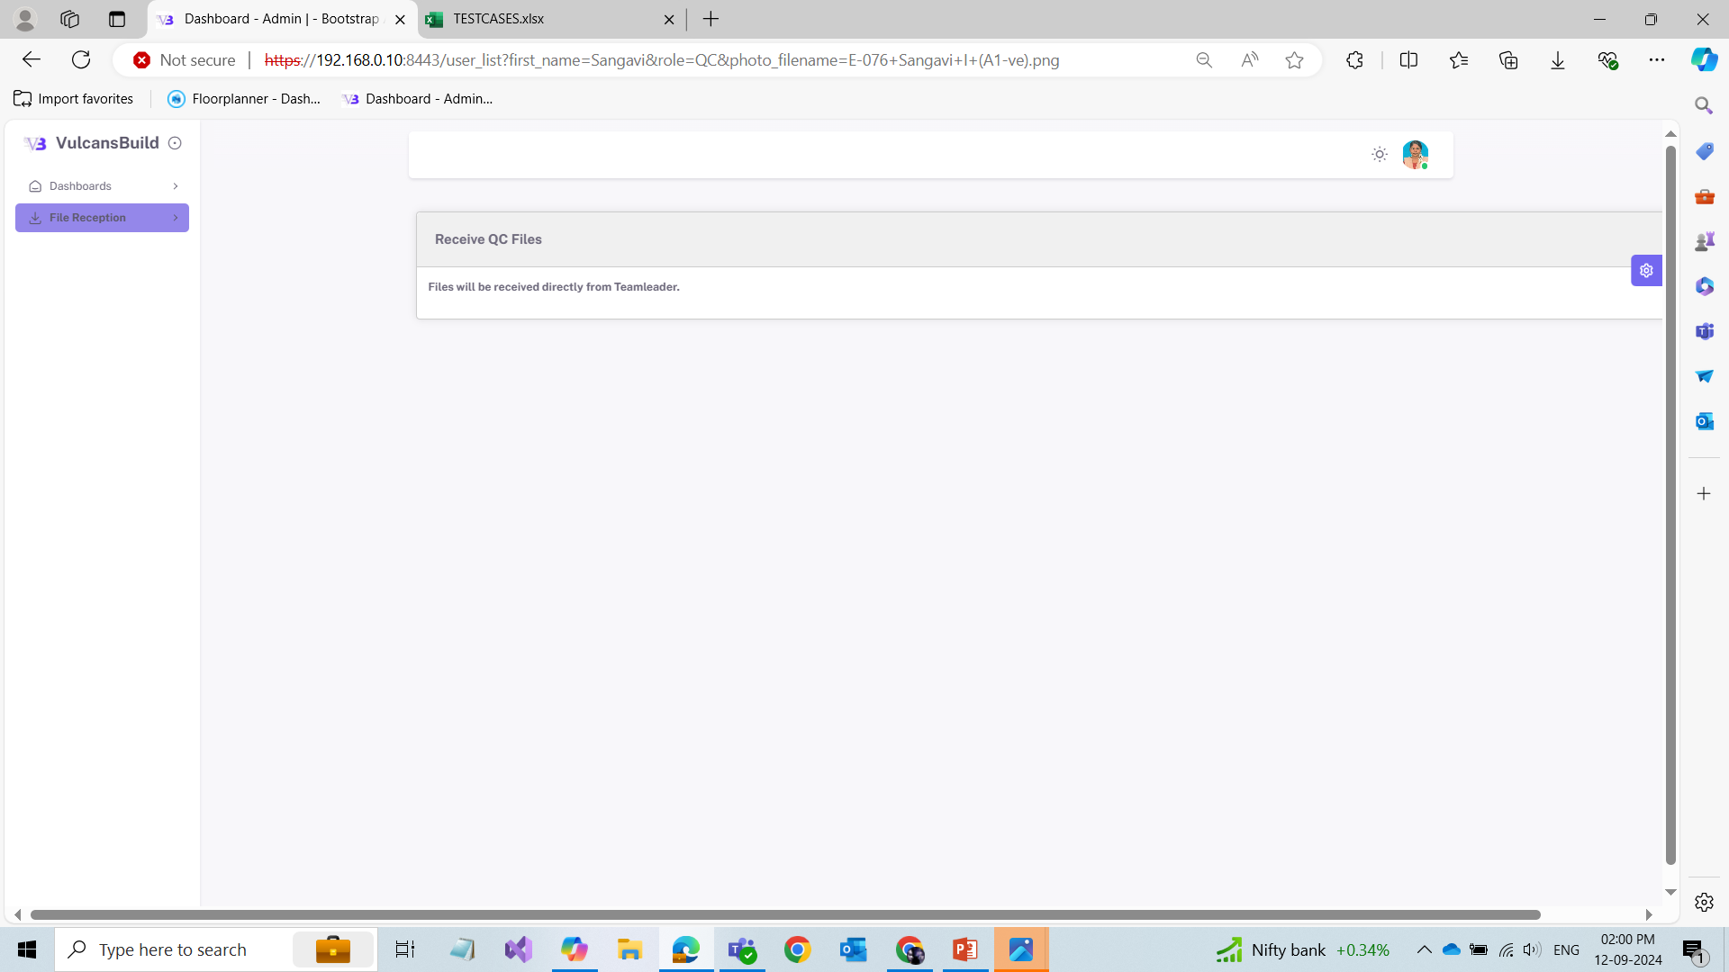
File Reception
In this menu, the teamleader receives the submitted files from the modellers along with the checklist.

Slide 19
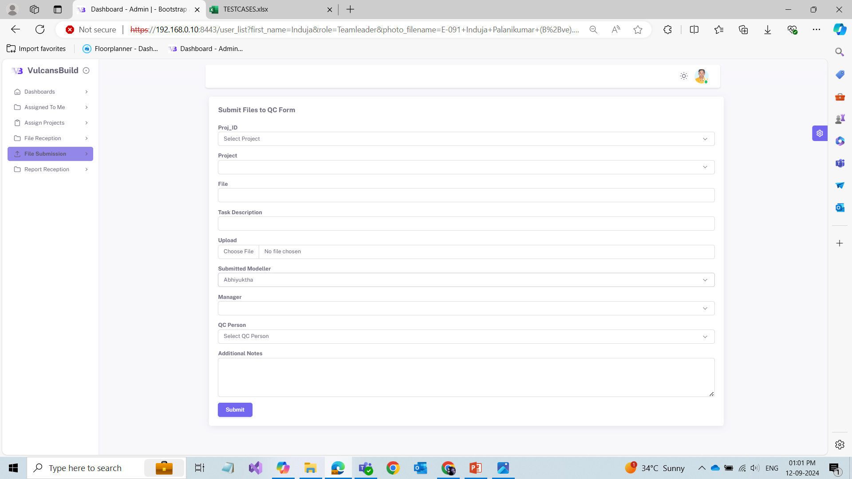
File Submission
In this menu, the teamleader assigns the submitted files to the “QC” along with the checklist.

Slide 20
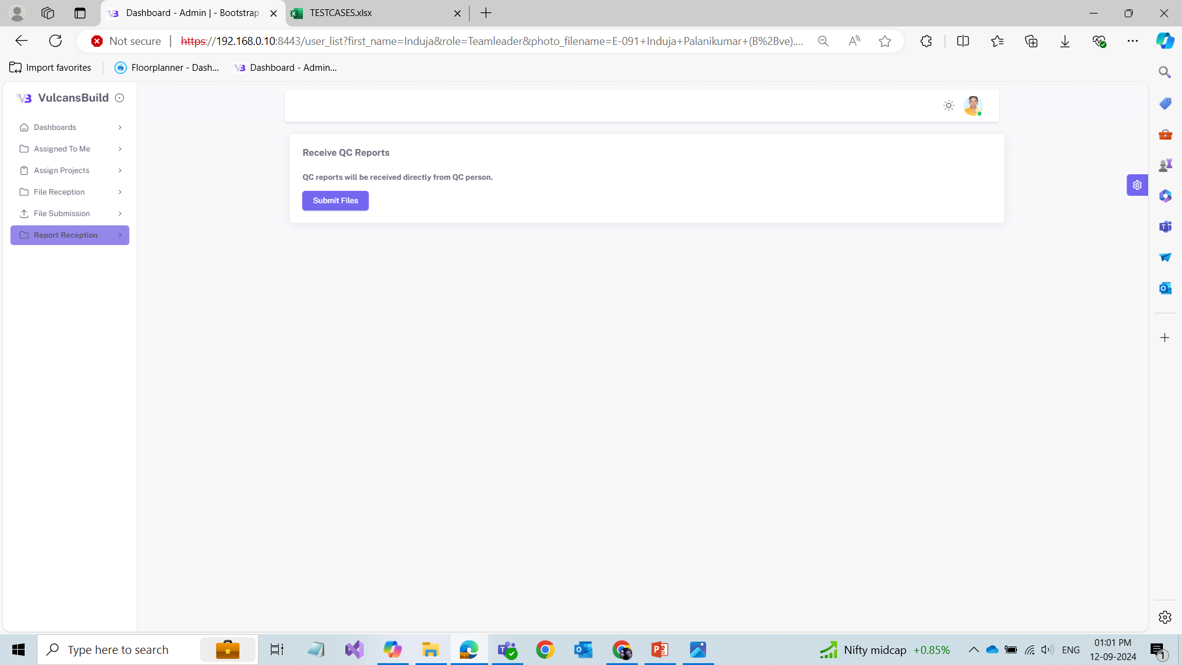
Report Reception
In this menu, The TL receives QC reports and scores from the QC person.
The TL sends the file directly to the manager if the score is above 90 or sending the files back to the modeller for rework.

Slide 21
Modeller
Dashboards
My Tasks

Slide 22
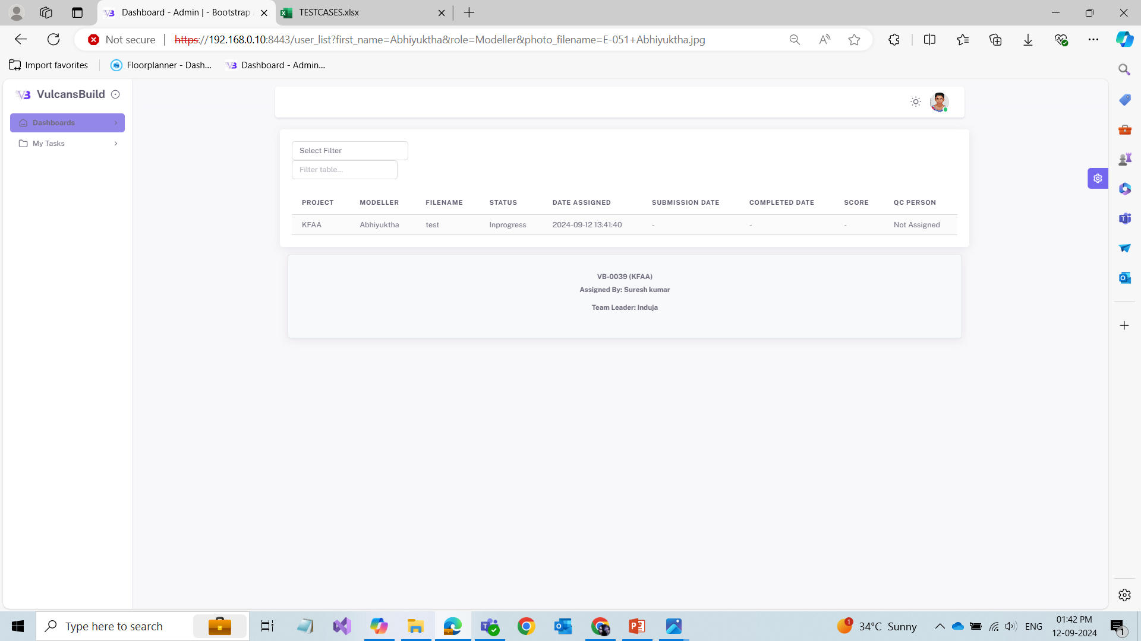
Modeller
Dashboards
The project that are assigned to the modeler get displayed in this menu

Slide 23
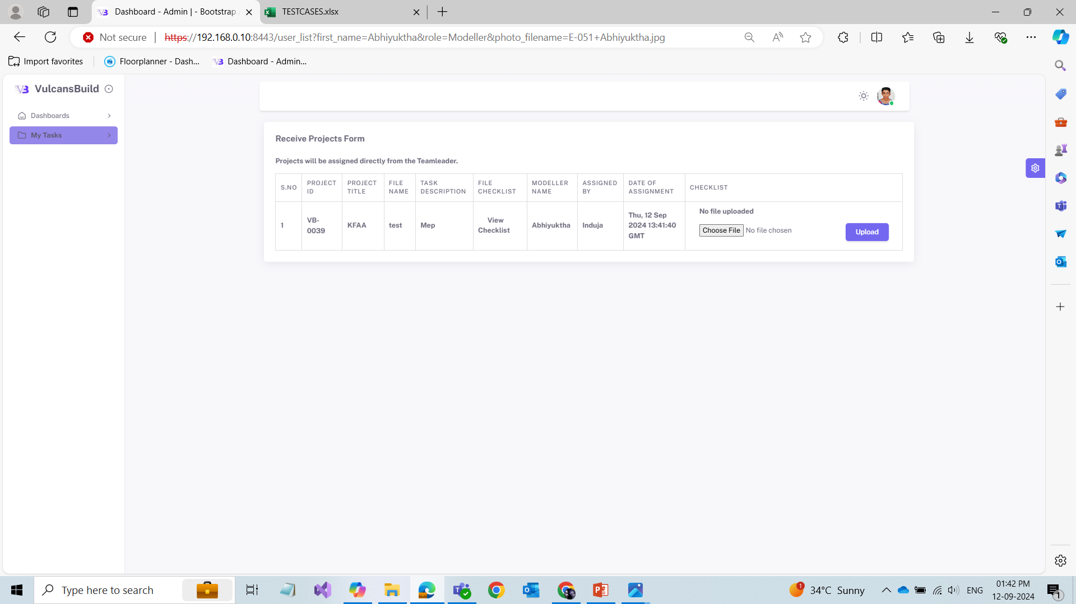
My Tasks
Modellers receive project files from the team leader.
Once the modeller completes the files, they upload a file alongwith the checklist. Those files alongwith the uploaded checklist are considered completed and submitted to the team leader.
If the files are without a checklist, they are considered in progress and have not yet been submitted to the team leader.

Slide 24
QC
Dashboards
File Reception

Slide 25
Dashboards
The project details are displayed in this menu

Slide 26
File Reception
The QC person receives submitted files from the team leader for quality checking.
The QC person then reviews the files and assigns QC scores.
Subsequently, the QC person prepares QC reports that include the scores.
Finally, the QC person sends the QC reports and scores to the team leader.

Slide 27
Thank you

